Slide 1

CSE101-Lec#22
Pointers in C

Slide 2
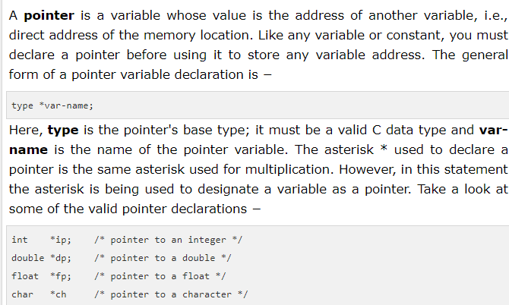

Slide 3
Pointer Variable Definitions and Initialization
Pointer variables
  Contain memory addresses as their values
  Normal variables contain a specific value (direct reference)
  Pointer is a variable that contains address of a another variable that has a specific value (indirect reference)
  Indirection – referencing a pointer value
count
7
countPtr
count
7

Slide 4
Pointer Variable Definitions and Initialization
Pointer definitions
  * used with pointer variables
      int *myPtr;
  Defines a pointer to an int (pointer of type int *)
  Multiple pointers require using a * before each variable definition
      int *myPtr1;
  Can define pointers to any data type
  Initialize pointers to NULL or an address

Slide 5
Pointer Operators
*
(indirection/dereferencing operator)

Slide 6
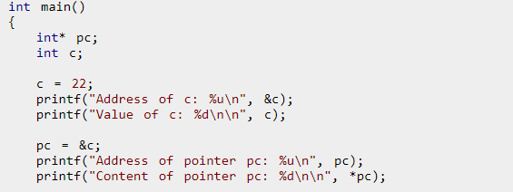
Example Code
Getch();
Return 0;
}

Slide 7
Pointer Expressions and Pointer Arithmetic
Arithmetic operations can be performed on pointers
  Increment/decrement pointer (++ or --)
  Add an integer to a pointer( + or += , - or -=)
  Pointers may be subtracted from each other
  but
  We cannot add two pointers.
  We cannot multiply 2 pointers.
  We cannot divide 2 pointers.(but we can compare 2 pointers)
Operations are meaningless unless performed on an array.

Slide 8
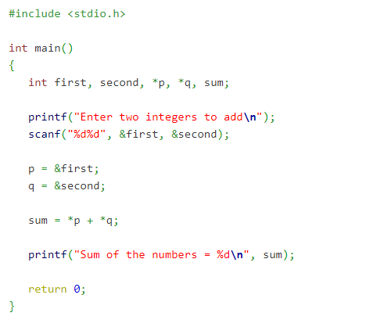
Add 2 variables using pointers

Slide 9
Area of a circle using pointers

Slide 10
Types of pointers
Null pointer
Void pointer
Wild pointer
Dangling pointer

Slide 11
Null pointer
That does not point to any valid memory address.
int *ptr=null;

Slide 12
Void pointer(
Is a pointer that can hold the address of variables of different data types at different times also called generic pointer.
The syntax for declaring a void pointer is
void *pointer_name;
Here, the keyword void represents that the pointer can point to value of any data type.
But before accessing the value through generic pointer by dereferencing it, it must be properly typecasted.
To Print value stored in pointer variable:
  *(data_type*) pointer_name;

Slide 13
#include<stdio.h>
void main()
{
int a=10;
char c=‘R’;
void *ptr;
ptr=&a; // assigns address of int variable a to ptr
printf(“\n value pointed to by generic pointer is %d”, (*(int *)ptr));
ptr=&c; // assigns address of char variable a to ptr
printf(“\n value pointed to by generic pointer is %d”, (*(char *)ptr));
getch();
}
Program to show use of void pointer.

Slide 14
Wild pointer
Pointer which are not initialized during its definition holding some junk value( a valid address) are Wild pointer.
Example of wild pointer:
int *ptr;
Every pointer when it is not initialized is defined as a wild pointer.
As pointer get initialized, start pointing to some variable its defined as pointer, not a wild one.

Slide 15
Dangling pointer
A pointer which is initially assigned some address but later on,the variable to which it is pointing,that value is erased,then it will act as dangling pointer.

